Slide 1
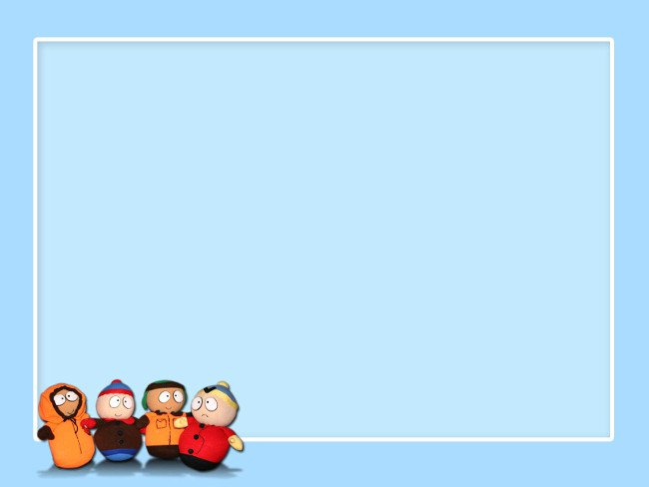

HO CHI MINH CITY UNIVERSITY OF TRANSPORT
PREVENTATIVE
MEASURES

Slide 2
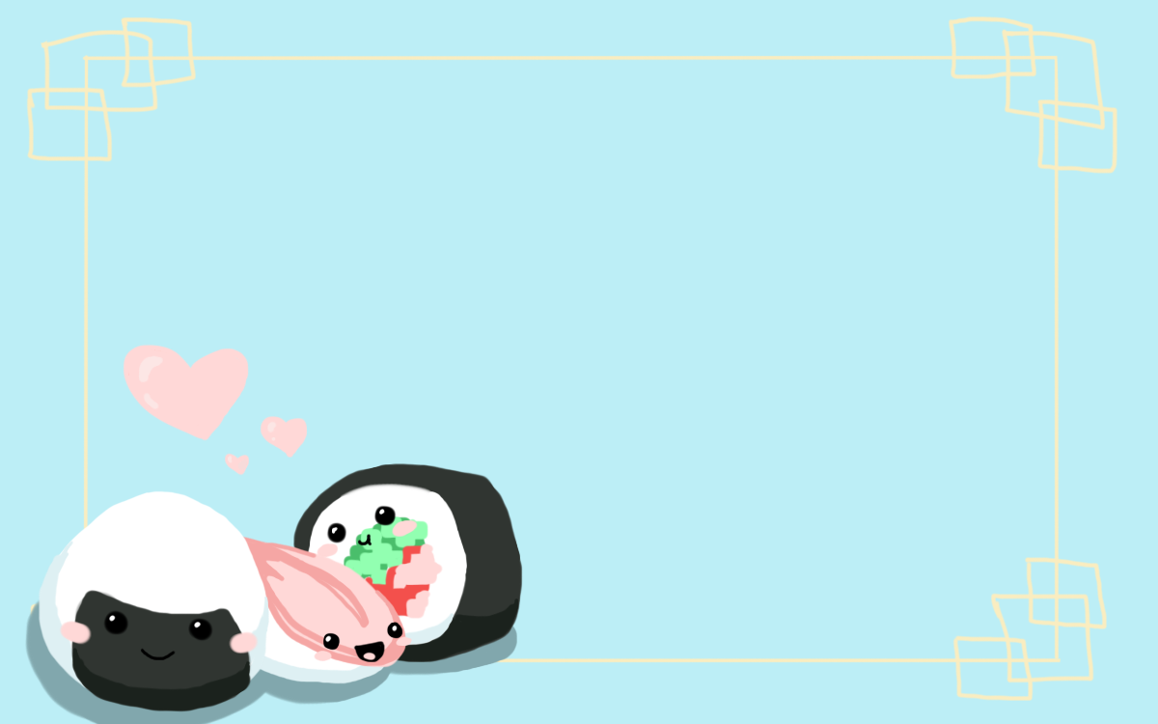
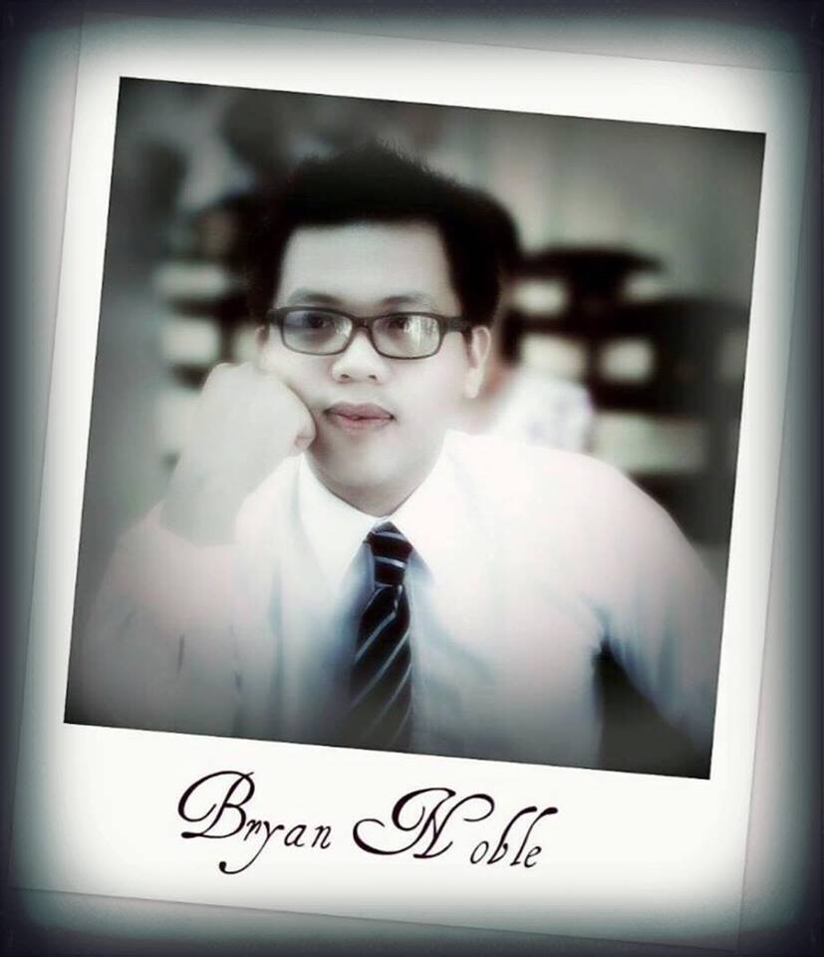

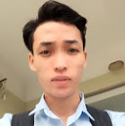


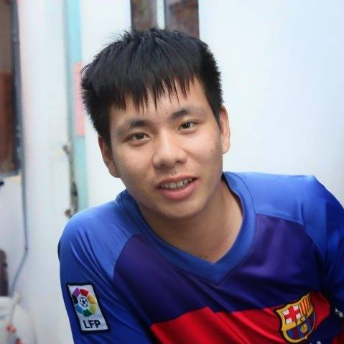

GROUP 4: IRON PERSON
Lê Kim Hòa
TEACHER
Đinh Hoàng Nam
Trần Thanh Lịch
Nguyễn Văn Thành
Bùi Quang Thọ
Trần Quyết Thắng

Slide 3


C
Review
O
Newords + Reading
N
Vocabulary
T
Listening + Speaking
E
Writing
N
Summary
T
Game

Slide 4

Warm up!!!

Slide 5

A ________ is a person who exploits computer hardware and software for their own purposes.

Slide 6

An add-on that makes a computer virus part of the host computer's operating system
A. Resident extension
C. Piggyback
B. Anti-antivirus virus
D. host

Slide 7

Viruses that become part of files but do nothing until activated can go unnoticed for months.
r _ _ _ d _ _ t _ _ r_s

Slide 8


Donald Greene has been arrested by Interpol on computer hacking charges. Interpol claims that Greene, a computer hacker, planted ________ on unwitting host computers. It is thought that Greene used a method called “______________" to gain access to computers when their owners logged in.

Slide 9

Anti-antivirus virus ?
A. a virus that attacks anti-virus software B. a program file that installs itself without permission C. an add-on that makes a computer virus part of the host computer's operating system D. a virus that copies its code over and destroys the files of the original data

Slide 10

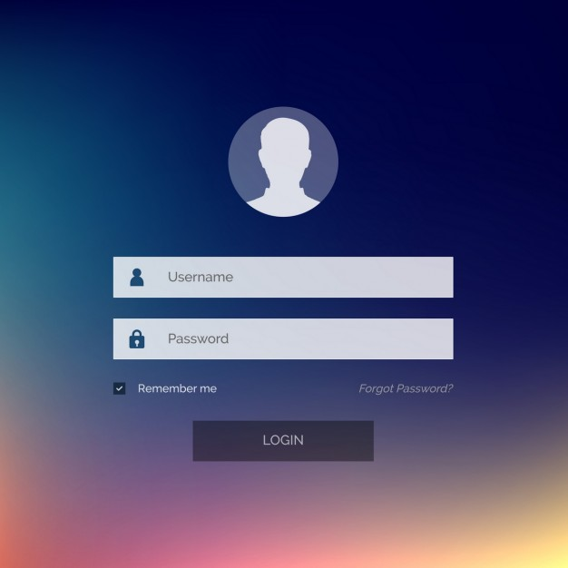
What is this?

Slide 11

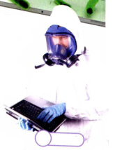
What is the mean Vietnamese?
“infect”

Slide 12

An ____________ is a computer virus that copies its code over and destroys the files of the original data.

Slide 13

Listen!
What is the mean Vietnamese?

Slide 14

To __________ a computer is to contaminate it with a computer virus.

Slide 15
End game!

Slide 16
A ________ is a person who exploits computer hardware and software for their own purposes.
Hacker

Slide 17
An add-on that makes a computer virus part of the host computer's operating system
A. Resident extension
C. Piggyback
B. Anti-antivirus virus
D. host

Slide 18
Viruses that become part of files but do nothing until activated can go unnoticed for months.
Resident virus

Slide 19
Donald Greene has been arrested by Interpol on computer hacking charges. Interpol claims that Greene, a computer hacker, planted ________ on unwitting host computers. It is thought that Greene used a method called “______________" to gain access to computers when their owners logged in.
viruses
piggybacking

Slide 20
Anti-antivirus virus ?
A. a virus that attacks anti-virus software B. a program file that installs itself without permission C. an add-on that makes a computer virus part of the host computer's operating system D. a virus that copies its code over and destroys the files of the original data

Slide 21
What is this?
Log in

Slide 22
What is the mean Vietnamese?
“infect”
Lây nhiễm

Slide 23
An ____________ is a computer virus that copies its code over and destroys the files of the original data.
Overwriting virus

Slide 24
Listen!
What is the mean Vietnamese?
Replicate

Slide 25
To ____ is to become a part of something.
imbed

Slide 26

New words

Slide 27

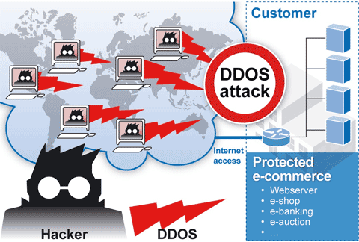
An attack is an attempt to get through computer security.
Attack
( noun)
/ə'tæk/
Sự Tấn Công

Slide 28
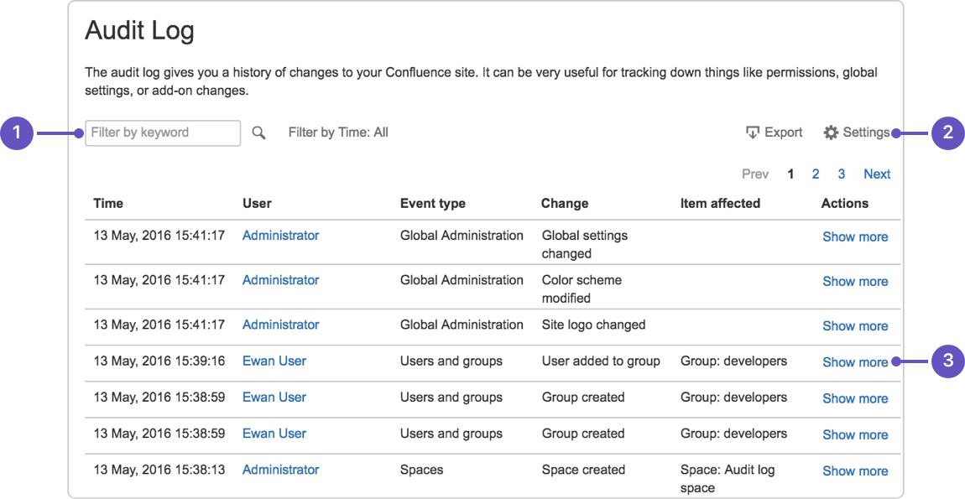
An audit log is a record of who has accessed a computer system and what actions they took.
Audit log
( noun)
/'ɔ:ditlɔg/
Nhật ký kiểm tra

Slide 29
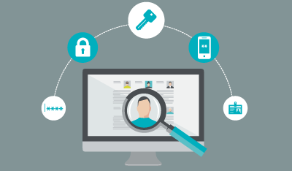
Authenticate something is to make sure that it is legitimate.
Authenticate
( noun)
/ɔ:'θentikeit/
Xác thực

Slide 30
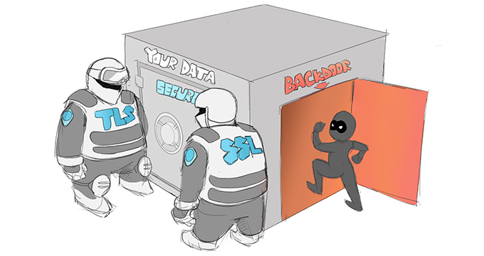
A backdoor is a hidden way to get by security in computers and programs, sometimes intentionally created.
Backdoor
( noun)
/ˈbæk.dɔː^{r}/
Cửa hậu / lối vào phía sau

Slide 31

A bug is a flaw in a computer program.
Bug
( noun)
/bʌg/
Lỗi

Slide 32
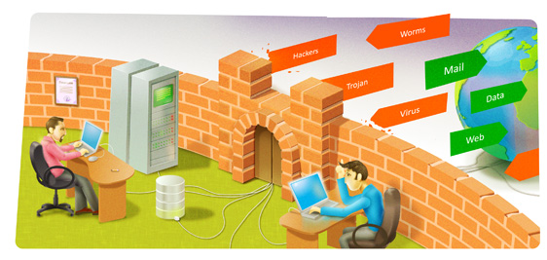
A firewall is a program that restricts access on a network
Firewall
( noun)
/ˈfaɪə.wɔːl/
Tường lửa

Slide 33
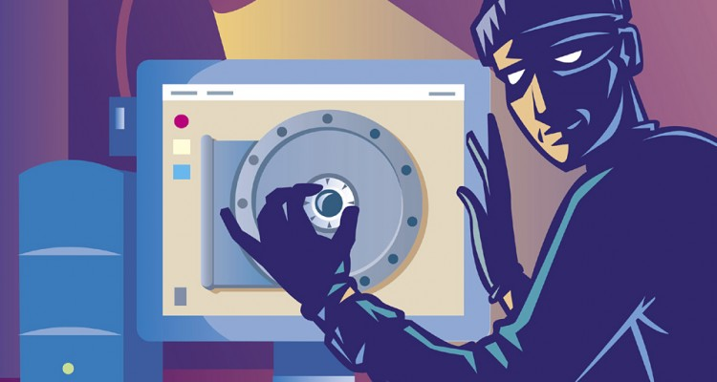
An intruder is a person or program that attempts to access a network or computer without permission.
Intruder
( noun)
/in'tru:də/
Xâm nhập viên

Slide 34
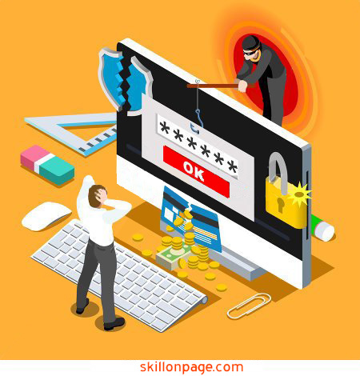
A keylogger is type of trojan virus that tracks what keystrokes are entered into a computer.
Keylogger
( noun)
/ki://´lɔgə/
Trình theo dõi thao tác bàn phím

Slide 35
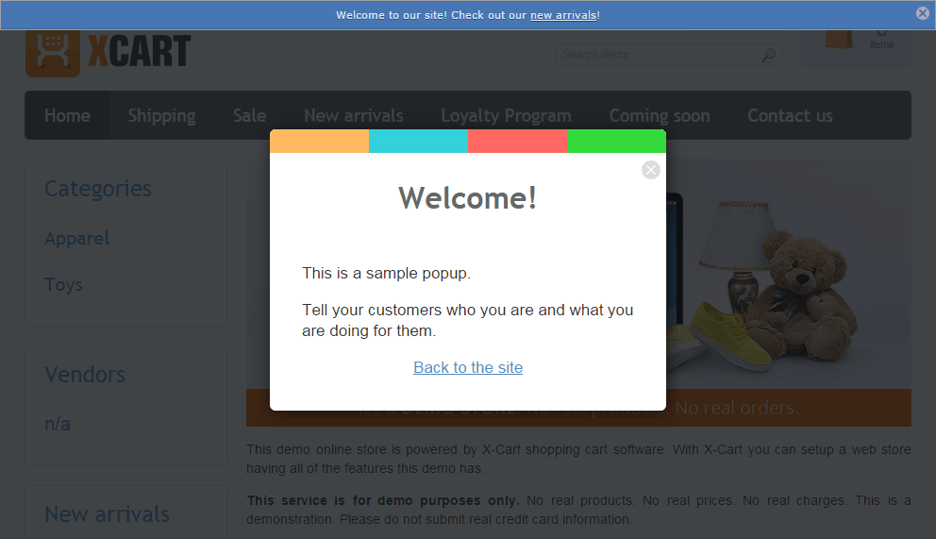
A popup is an advertisement that suddenly appears in a new window in an Internet browser.
Popup
( noun)
?
Cửa sổ quảng cáo

Slide 36
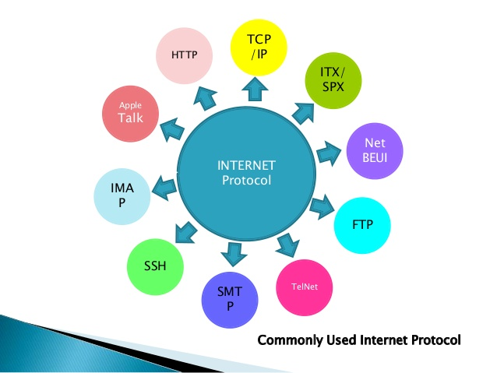
Protocol is a set of rules that must be followed for the sake of security.
Protocol
( noun)
/ˈprəʊ.tə.kɒl/
Giao thức

Slide 37

Security is a the state of being safe from attack.
Security
( noun)
/si'kjuəriti/
Bảo mật an toàn

Slide 38
Reading

Slide 39
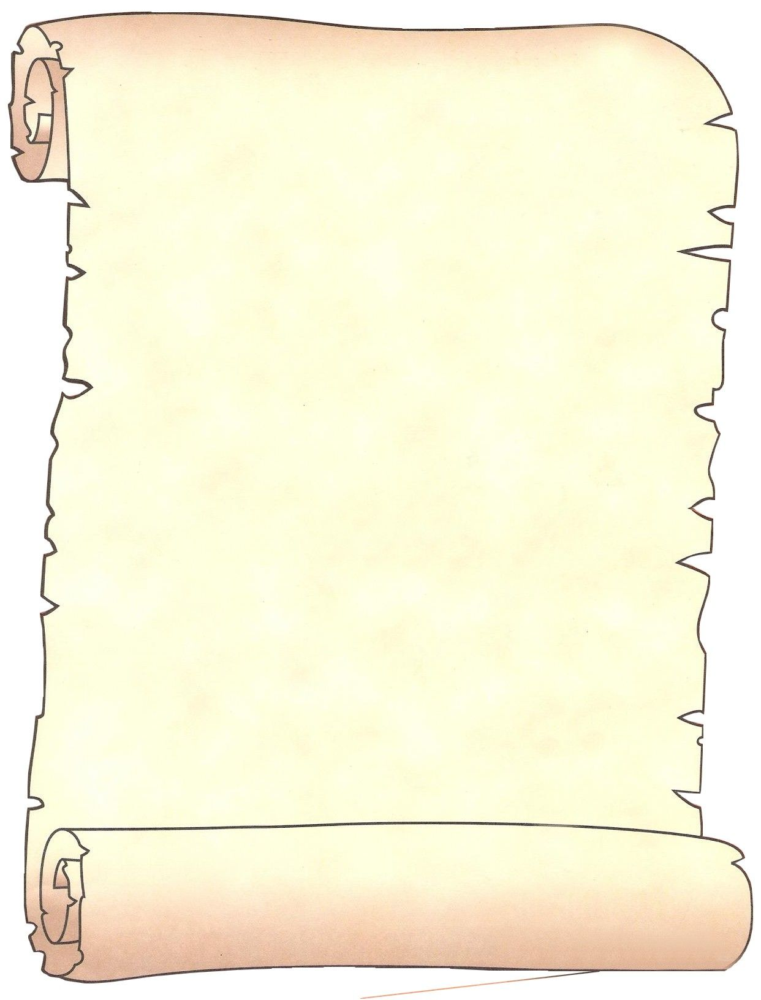
From: jared.greene@harper.com To: allstaff@harper.com Dear Harper Company Staff, By now, you are all aware of the recent security breach. The IT department has traced it to a bug in our browsers. This bug created an unwanted backdoor in the network, allowing intruders in. They installed keyloggers that track our passwords. The IT department removed the keyloggers, and the software supplier is releasing a patch that will fix this error. We will inform you when this patch becomes available.
However, this provides a good opportunity to remind you of the measures we must take to make our network safer. Remember, you must keep the firewall settings as strict as possible on your computer. This prevents attacks from hackers and keeps certain types of malware out of the system.
Be cautious when downloading files. Perform a virus scan on every email attachment. Also, enable your browsers to block popups. Otherwise, spyware can get on to your computer.
Only download company-approved programs to your computer. Unauthorized programs may contain Trojans that can do irreversible damage to our system. Please consult the IT department for a list of authenticated programs.
In addition, we will review our audit logs from now on. This is to make sure no one violates security protocol. Employees violating protocol will receive disciplinary action. Jared Greene Manager, Harper Company

Slide 40
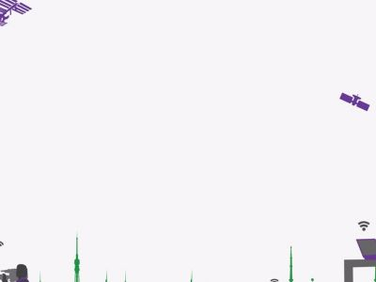
2
Read the email about safety measures. Then, choose the correct answers.
1 What is the email mainly about? A improving security at the company B detecting keylogger programs C installing a patch on a web browser D punishing employees for violating security protocol 2 The company will monitor employees by ... A installing spyware. B performing virus scans. C reviewing the audit logs. D looking for authenticated programs.
3 What can you infer about Harper Company? A They have authenticated the patch. B They already have a virus scan program. C They allow many authenticated programs. D This is their first security breach.

Slide 41
Vocabulary

Slide 42
3
Macth the words (1-8) with the definitions (A-H)
1. __ popup 2. __ bug 3. __ security 4. __ audit log
5. __ backdoor 6. __ patch 7. __ protocol 8. __ intruder
C
B
E
G
F
H
A
D
A set of rules
B error in a program
C unwanted advertisements on a web browser
D someone who accesses a system without permission
E safety of a computer system and its data
F part of a program giving undesired access
G record of who has used a computer and what they’ve used it for
H code to fix errors in a program

Slide 43
4
Fill in the blanks with the corect words from the word bank
Authenticate keylogger attack firewall patch
Management has to __________ the program before you download it.
A (n) ________ will record your password.
Without antivirus software computers are open to a(n) ______
Put up a(n) _________ to keep hackers out of your computer.
Download the ________ to make the program work corectly.
Authenticate
keylogger
attack
firewall
patch

Slide 44
5
Listen and read the email about safety measures again. What should users do when popups appear on a web browser ?
Users should make sure their browsers block unwanted advertisements/popups.

Slide 45
Listening

Slide 46
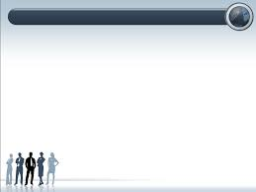
6
Listen again and complete the conversaion
Employee 1: None of my programs have online access.
Employee 2: What about ① ______ _________ ?
Employee 1: The browser opens, but I can't access any websites. Most importantly, I can't use the email client.
Employee 2: That's a big problem.
Employee 1: I know. I think ② ____ _______ __ _______ .
Employee 2: Are you sure? The company's ③_______ __________ ____________is pretty powerful.
Employee 1: I know, and ④ _____ ______ _____ _____ _________ .
Employee 2: Oh, the firewall. How high are your settings?
Employee 1: ⑤ ____ _______ _____ ___________ .
Employee 2:⑥ __________ _______ ___________. You need to lower the level if you want your programs to work.
your
browser
I
have
a
virus
new
antivirus
software
we
just
got
the
firewall
As
strict
as
possible
There's
your
problem

Slide 47
7
Mark the following statements as true(T) or false(F).
① ____The antivius solfware is causing the employee's problem.
② ____The browser cannot access any online information.
③ ____The employee's firewall settings are too strict.
F
T
T

Slide 48
Speaking

Slide 49
8
With a partner, act out the roles below based on Task 7.Then, switch roles.
 USE LANGUAGE SUCH AS:
What about your browser?
How high are your settings?
You need to lower the level if you want your programs to work.

Slide 50
A: Hi, what seems to be the problem ?
B: None of my programs have online access.
A: What about your browser ?
B: The browser opens, but I can't access any websites. Most importantly, I can't use the email client.
A: That's a big problem.
B: I know. I think I have a virus .
A: Are you sure? The company's new antivirus software is pretty powerful.
B: I know we just got the powerful.
A: Oh, the firewall. How high are your settings?
B: As strict as possible.
A: There's your problem. You need to lower the level if you want your programs to work.

Slide 51

Homework

Slide 52
9
You work in an IT department. Using the email and conversation from Task 8, write an email to your co-workers about security (120-150 words). Talk about:
• What security measures there are • What threats there are to computers • How the company plans to monitor its employees on the Internet

Slide 53

Summary

Slide 54
How do people keep their computers sate?
People choose a number of ways to keep their computers safe. Most start by frequently updating their operating system by turning on the auto-update. They install Anti-Virus and Anti-Spyware Protection to block various malwares. To protect themselves against Trojans, they use a firewall and keep their settings as strict as possible to increase the level of security. Many users are also careful when opening e-mail attachments and about which sites they visit. They don’t store credit card or other personal information on their computers. However, those who do, always encrypt data making it difficult for hackers to decipher.

Slide 55
Why would a company worry about security?
Due to the highly computerized environment we are now working in, companies across the globe are concerned about their security. In the past, only a computer expert could hack into a computer, unlike today where there are readily available tools to make it much easier. A company can lose destroyed by a virus. Employers are also worried about internal threats from employees. Although it is illegal, staff members often steal customer and contract lists proposals and product information to take to a new job. Disgruntled workers may even plant unauthorized programs destroying important documents.

Slide 56


